Slide 1
MORE EXERCISES FOR SCHEME
2020/12/31
Notes:
12.31：结合61a上的部分针对性的习题，串讲复习scheme中一些难点

Slide 2
MACROS

Slide 3
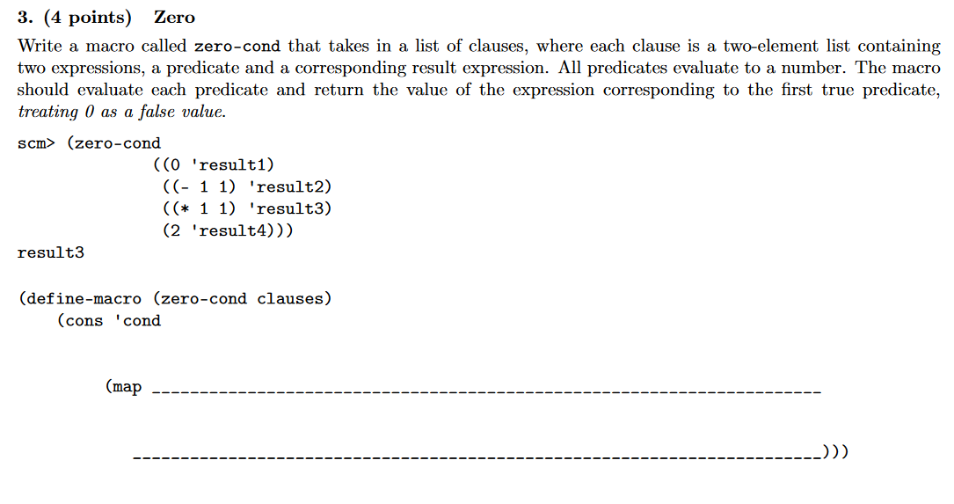
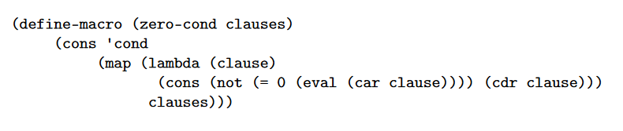
SUMMER 2018 MOCK FINAL: Q3

Slide 4
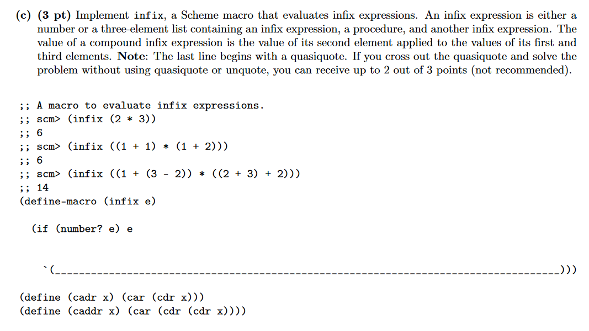
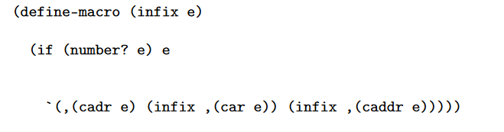
FALL 2018 FINAL: Q6(C)
Notes:
(define l ‘(1 + 2))
取operator：(cadr l)
取operand: (car l) (caddr l)
Apply: ((cadr l) (car l) (caddr l))
To macro:…

Slide 5
MORE PRACTICE PROBLEMS
Summer 2018 Final: Q8
Spring 2018 Final: Q6(c)

Slide 6
TAIL RECURSION

Slide 7
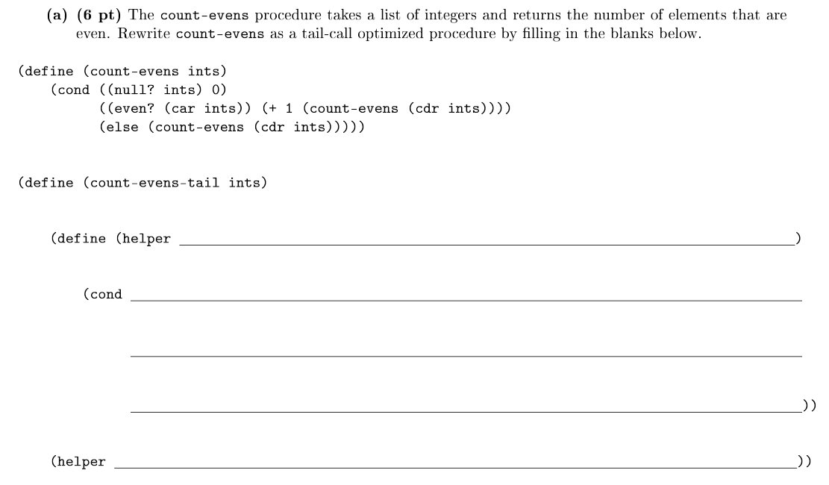
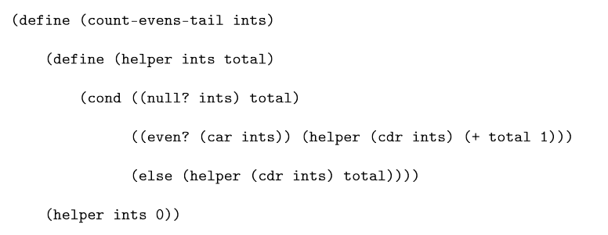
SPRING 2019 FINAL: Q7(A)

Slide 8
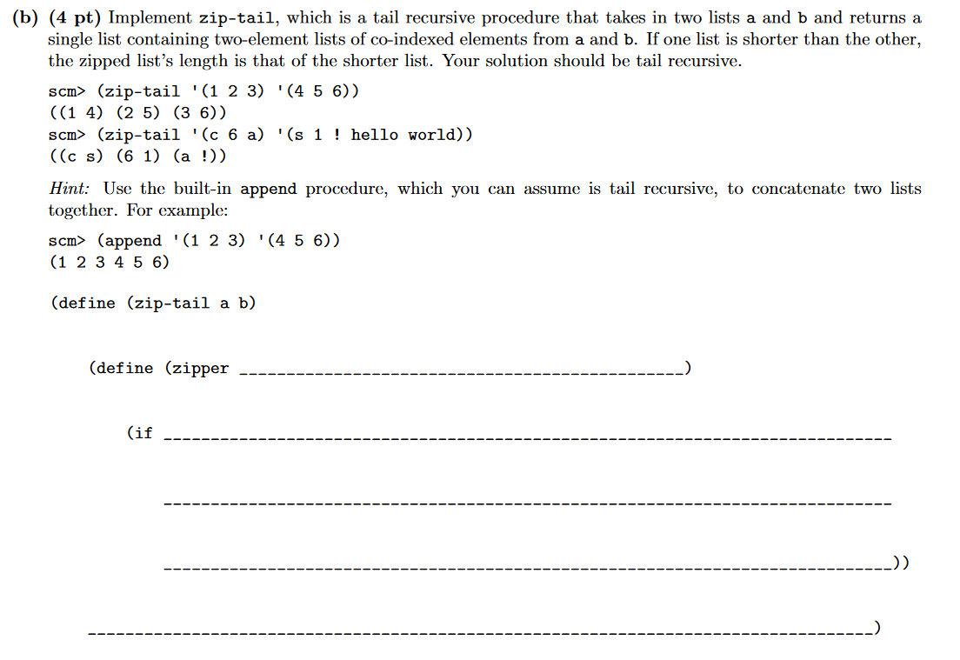
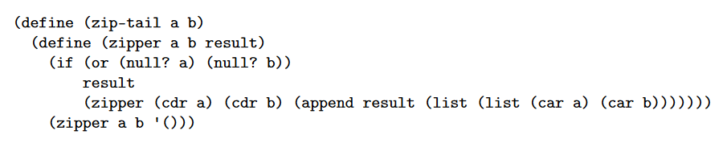
SUMMER 2018 MOCK FINAL: Q5(B)

Slide 9
STREAMS

Slide 10
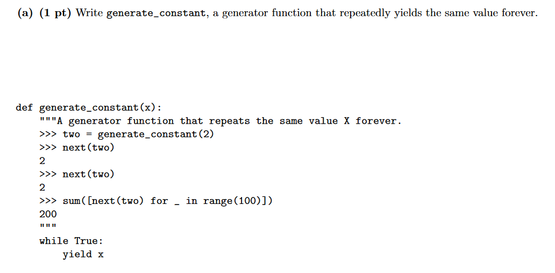
SUMMER 2018 FINAL: Q7(A)
Notes:
这个例题可以展现python和scheme中lazy evaluation的不同和共通之处

Slide 11
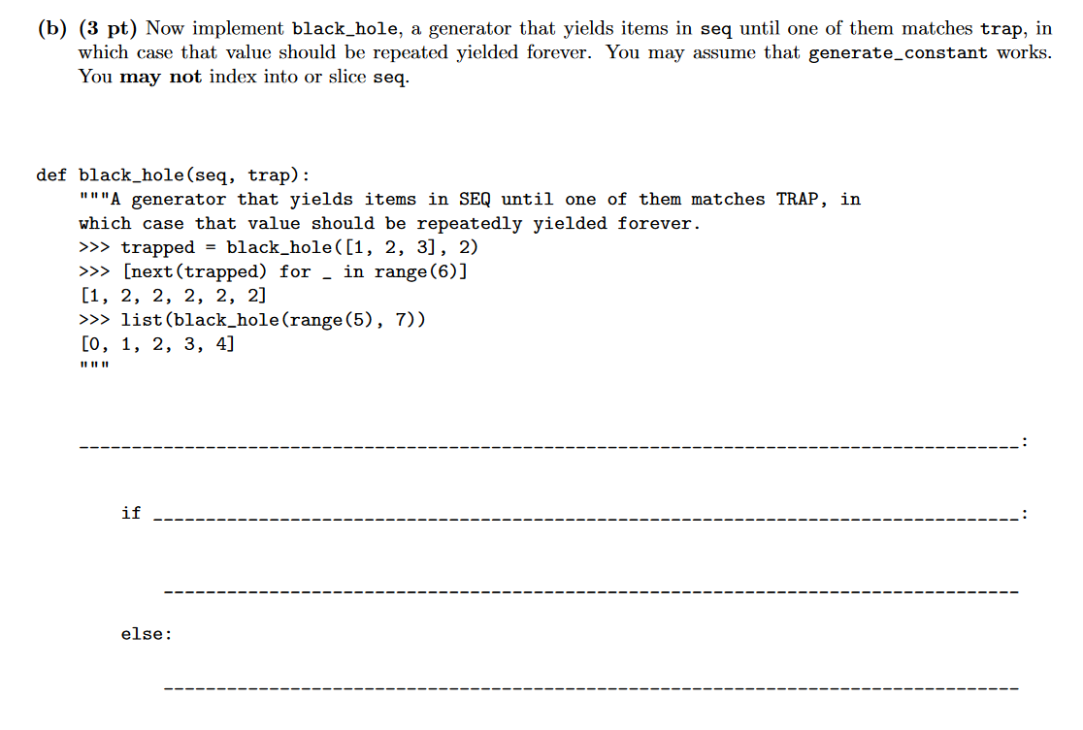
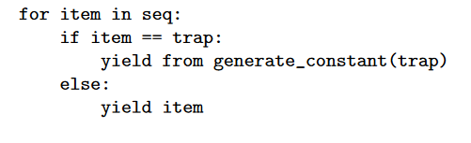
SUMMER 2018 FINAL: Q7(B)

Slide 12
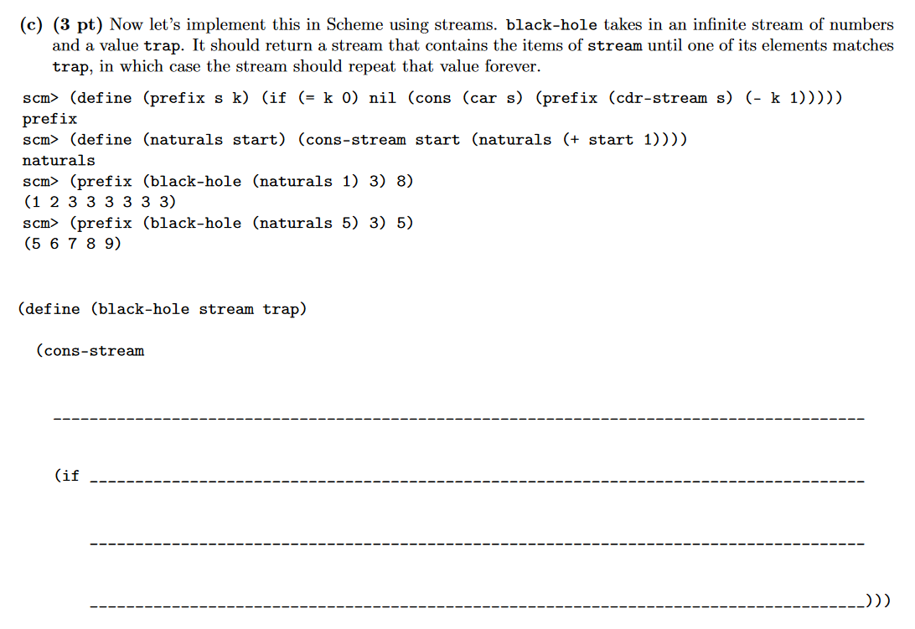
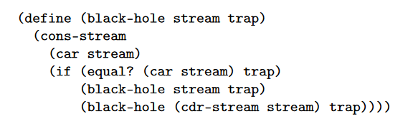
SUMMER 2018 FINAL: Q7(C)

Slide 13
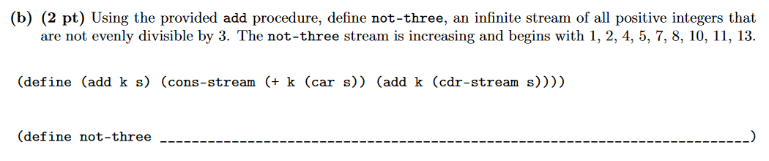
FALL 2018 FINAL: Q6(B)

Slide 14
MORE PRACTICE PROBLEMS
(Summer 2015) Albert's Streams Problems

